Slide 1
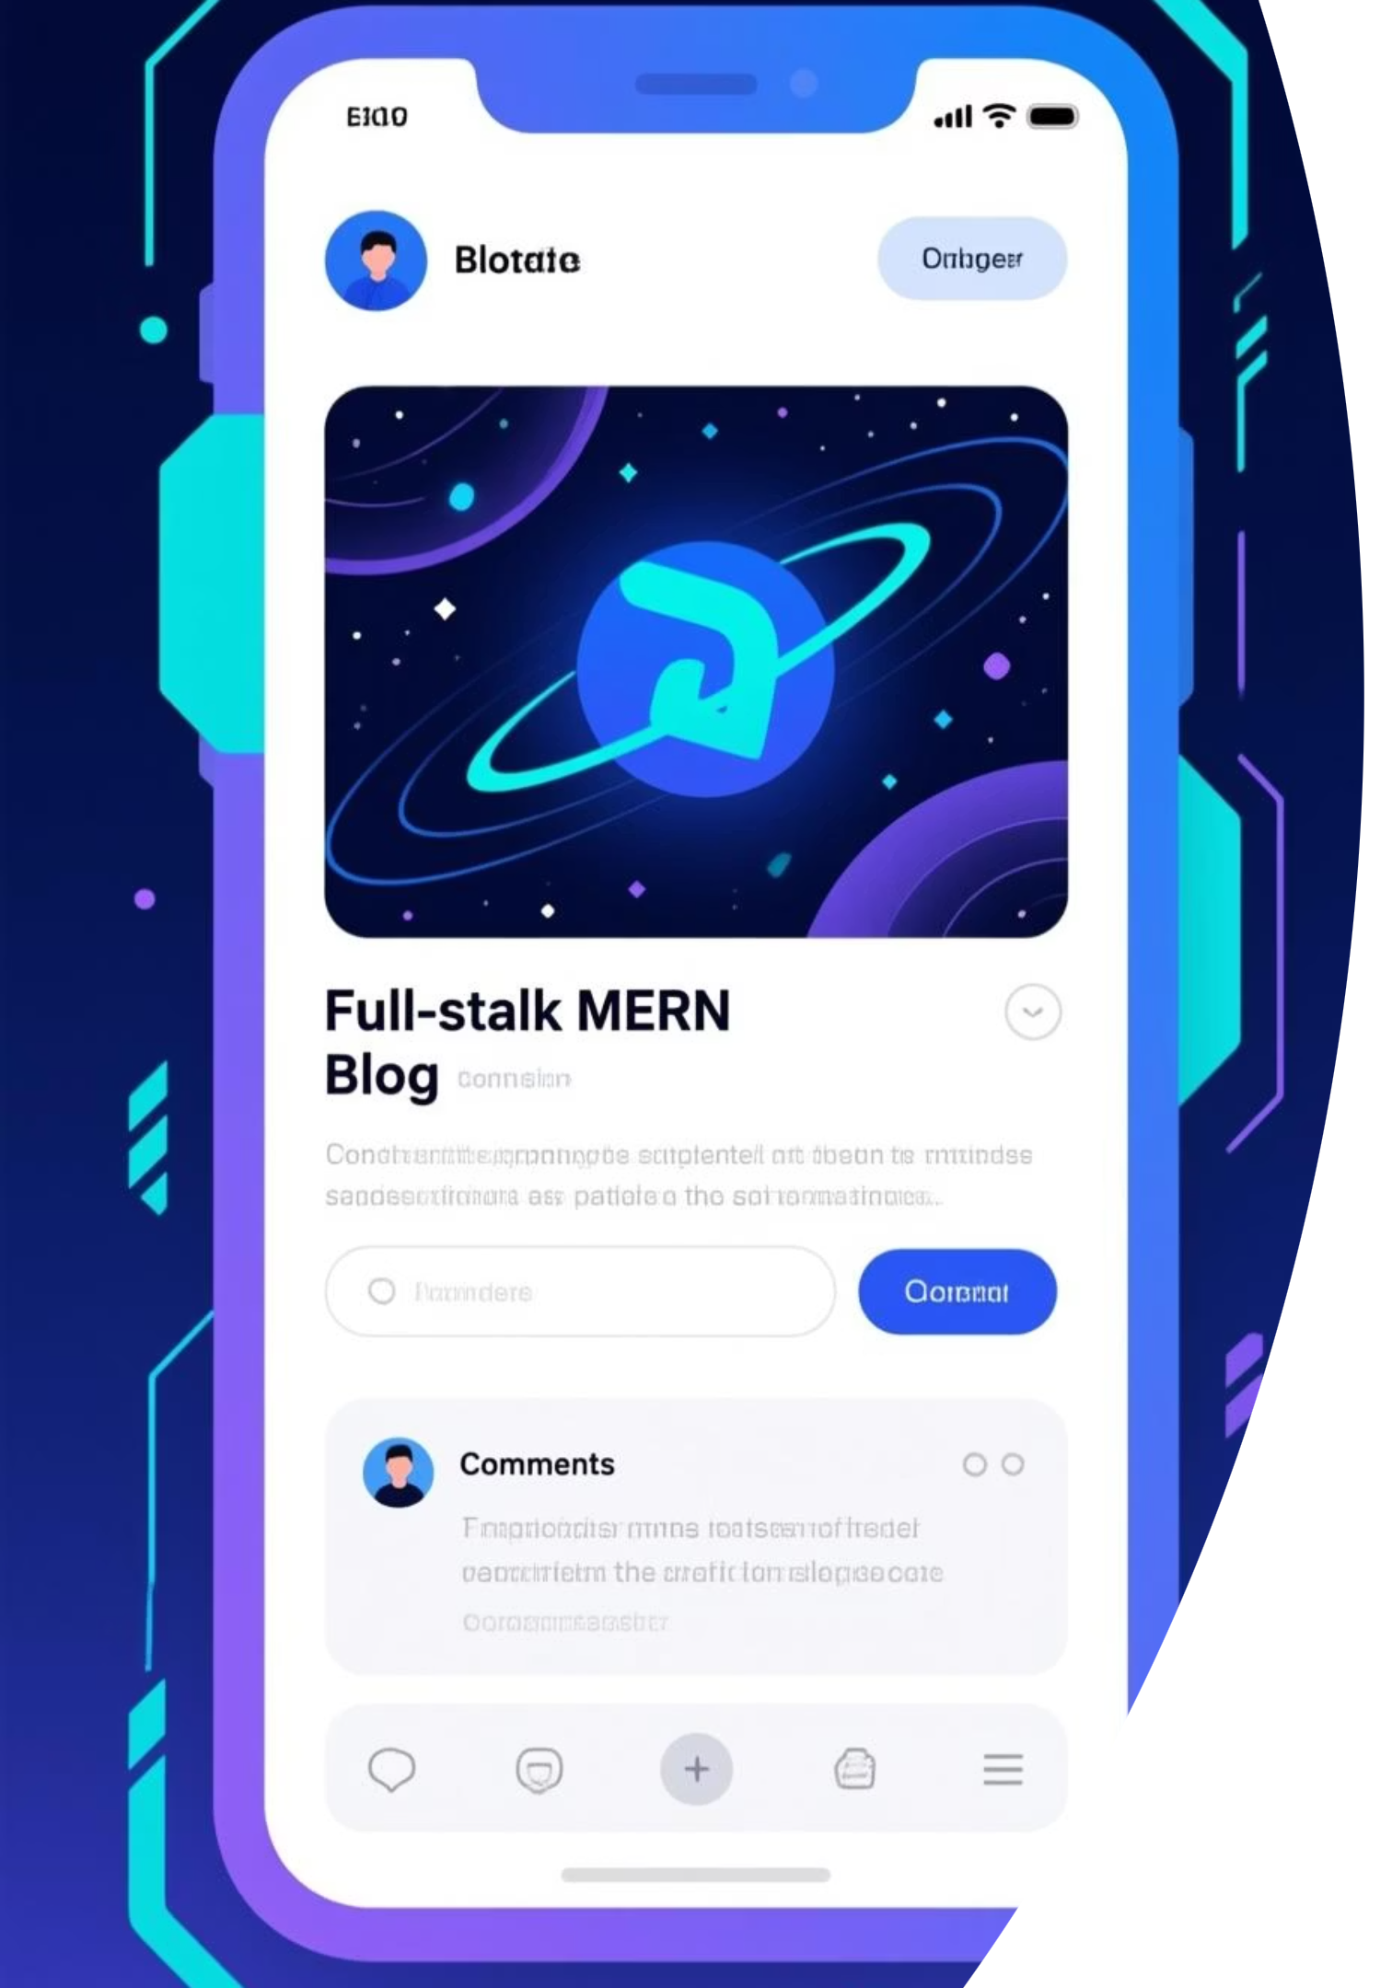
Blog-App
Full-Stack MERN Blog Application
MongoDB · Express.js · React · Node.js
Secure, Production-Ready Blogging Platform
Demonstrates CRUD, OOP, Authentication & File Export
Academic & Industry-Aligned Project
Presented by: LABBI SRIKANTH BABU
Project Type: Full-Stack MERN (EXPOSYS)

Slide 2
Project Overview
What is Blog-App?
A feature-rich blogging platform built using MERN stack
Focuses on real backend workflows, not just UI
All data is 100% persisted in MongoDB
Designed for academic excellence + production readiness
Key Objective
Build a secure, scalable blog application demonstrating modern web development and OOP principles.

Slide 3

Key Features
Core Functionalities
🔐 Secure Authentication (Signup / Login / Logout)
📝 Blog Management (Create, Read, Update, Delete)
🔍 Advanced Search using MongoDB Text Index
📊 Export Blogs to Excel (.xlsx)
📄 Export Individual Blog to Word (.docx)
🔒 Ownership-based authorization
📱 Responsive & modern UI

Slide 4
Technology Stack
Backend Technologies
Frontend Technologies
Node.js – Runtime environment
React (Vite) – UI development
Express.js – REST API framework
React Router – Routing
MongoDB – NoSQL database
Axios – API communication
Mongoose – ODM for MongoDB
JWT – Authentication & authorization
bcrypt – Password hashing
exceljs & docx – File export

Slide 5
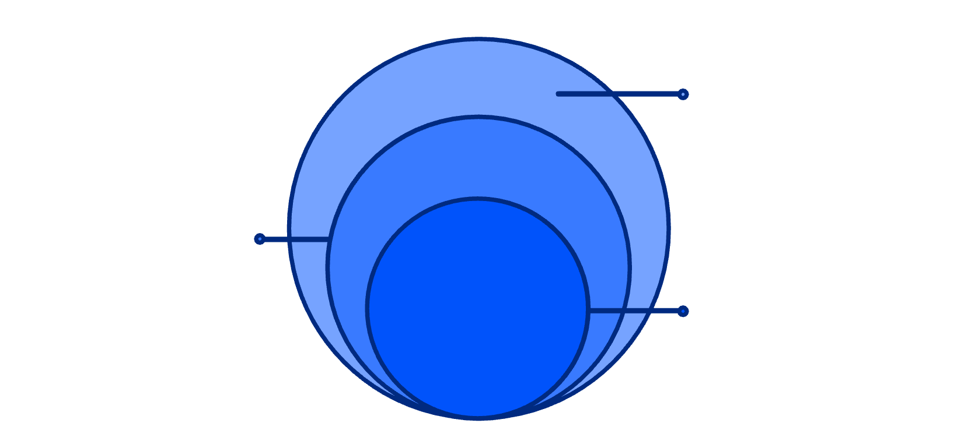
System Architecture
Layered Architecture (MVC + Service Pattern)
Database (MongoDB)
Frontend (React)
Collections: Users, Posts, Tokens
Pages, Components, Context
Backend (Node + Express)
Backend (Node + Express)
Routes → Controllers → Services → Models
Routes → Controllers → Services → Models
Frontend (React)
Database (MongoDB)
Pages, components, and context
Users, Posts, Tokens collections
Why this architecture?
Clean separation of concerns
Easy maintenance and scalability
Strong OOP alignment

Slide 6

OOP Principles Demonstrated
1
2
Encapsulation
Abstraction
Mongoose schemas encapsulate data & validation
Service layer hides database logic from controllers
3
4
Inheritance
Polymorphism
BaseService reused by UserService & PostService
Export service behaves differently for Excel & Word
✔ All four OOP pillars clearly implemented

Slide 7

Authentication & Security
Secure User Management
Password hashing using bcrypt (10 rounds)
JWT-based authentication
Access Token (15 minutes)
Refresh Token stored in DB
Protected routes using middleware
No auto-login after signup (security best practice)
Ownership checks for edit/delete operations
Result:
Secure and controlled access

Slide 8
Blog CRUD & Search Workflow
Blog Operations
Search
Create Blog
MongoDB text index on title & description
Authenticated users only
Backend-driven search (not frontend filtering)
Stored directly in MongoDB
Read Blogs
Fetch all / single post
Update Blog
Only author can update
Delete Blog
Permanent deletion with confirmation

Slide 9
File Export & Database Verification
File Export
Database Verification
Excel Export
MongoDB Compass used for validation
All blog posts
Verification scripts confirm:
Structured columns & formatting
Users persisted
Word Export
Posts persisted
Individual blog post
Search index exists
Professional document format
✔ Data integrity guaranteed

Slide 10
Conclusion & Project Status
Project Summary
Project Status
Fully functional MERN Blog Application
✅ Production Ready ✅ Tested & Verified ✅ Mentor-Demo Ready
All mandatory requirements satisfied:
CRUD operations ✅
Future Enhancements
Excel & Word export ✅
OOP principles ✅
Comments & likes
MongoDB persistence ✅
Rich text editor
Cloud image storage
Role-based admin panel
GITHUB REPO:
https://github.com/LABBISRIKANTHBABU/Exposys

